Slide 1
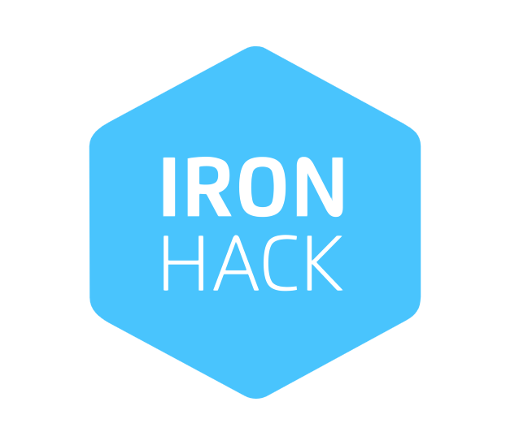
Is it worth investing in the strategic mobile games genre?
The IronHack games company does not have any game in this genre.
However, we do have questions that must be answered prior to investing.

Slide 2
Here are some business questions that we aim to answer:
What is the profile of the players?
Do they spend frequently?
Does the pattern follows the Pareto’s principle?
20% of the customers/ users are the spenders? About 3% to 5% of the users are the very high spenders?
How much are the high spenders spending?
What type of content makes players spend the most?
Do casual and active players spend differently?
How does being a leader in real life, in-game, or both affect spending?

Slide 3
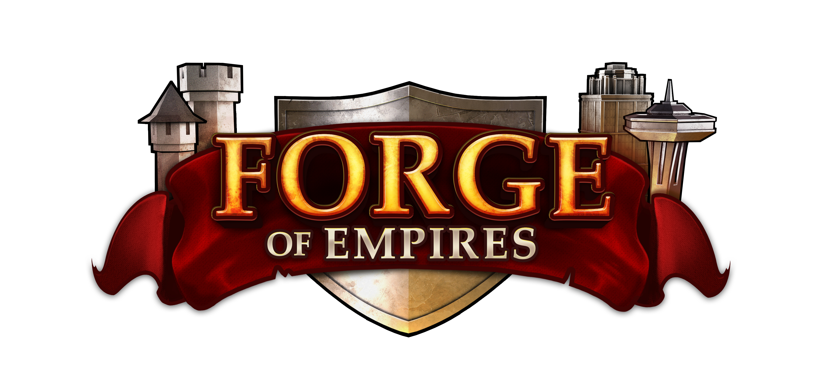
To answer these questions, we picked a very solid mobile game in this genre, called Forge of Empires:
Game in numbers:
Source: Inno Games
Released in 2012, the game has over 130 million registered players.
In August 2023, Forge of Empires surpassed €1 billion in lifetime revenue.
Share of 2022 revenues from players who had been playing for at least 3 / 5 years: 34% / 18%, respectively. ​ ​
Average playtime of game content added since launch: approx. 5 years ​
Average playtime of all currently available content: approx. 6 years
To analyze the players, we sent a survey in the English International Server using an online form.
We got 81 responses that were targeted toward players' profiles and expenses.
Our sample shows that 50% of the players have been playing the game for more than 5 years.
The majority of players, 77%, have between 34 and 64 years old.
(Click on the Forge of Empires logo to access the dashboard)

Slide 4
Business Recommendations and Conclusions:
Investing in events with exclusive buildings must be a top priority.
Exclusive content and the aesthetic of the cities seems to be more appealing to players than competition or game exploration.
First-time spenders, who make up 16% of the players, heavily buy diamonds to spend in events.
Heavy spenders also choose events as the main place to invest.
Moderate spenders like single-player activities:
Players who typically spend between 50€ and 100€ prefer individual challenges as their second choice for spending.
Investing in challenges that test city-building should also be prioritized.
The sample indicates how Inno Games handles its game throughout thr year. We should follow the same direction.
The game hosts 10 events per year, each lasting between 20 to 30 days.
New era content is released once per year (in some cases it takes 1.5 years)
Competitive content is usually released every 4 years.
Competitive content is important to keep players engaged, but should not be top priority.

